Slide 1
Customer Churn Prediction
FGSSR DS540 | 18th May 2025
This project aims to predict which customers are likely to leave a subscription service. It uses customer data to support retention strategies.

Slide 2





Nourhan Khaled
Fatimah Ehab
Hend Labib
Mayar Mustafa
Mona Elgoba
Our team

Slide 3
01
02
03
04
05
06
Content
Dataset Description
EDA: Visualization
Pre-processing
Modeling
Evaluation
Deployment

Slide 4

Dataset Description
Target Variable:
Churned Customers who left within the last month
Features:
Services that customer has signed up for – phone, multiple lines, internet, online security, online backup, device protection, tech support, and streaming TV and movies
Customer account information – how long they’ve been a customer, contract, payment method, paperless billing, monthly charges, and total charges
Demographic info about customers – gender, age range, and if they have partners and dependents

Slide 5
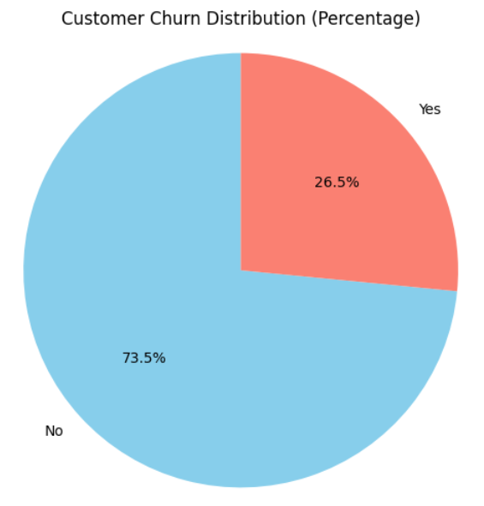
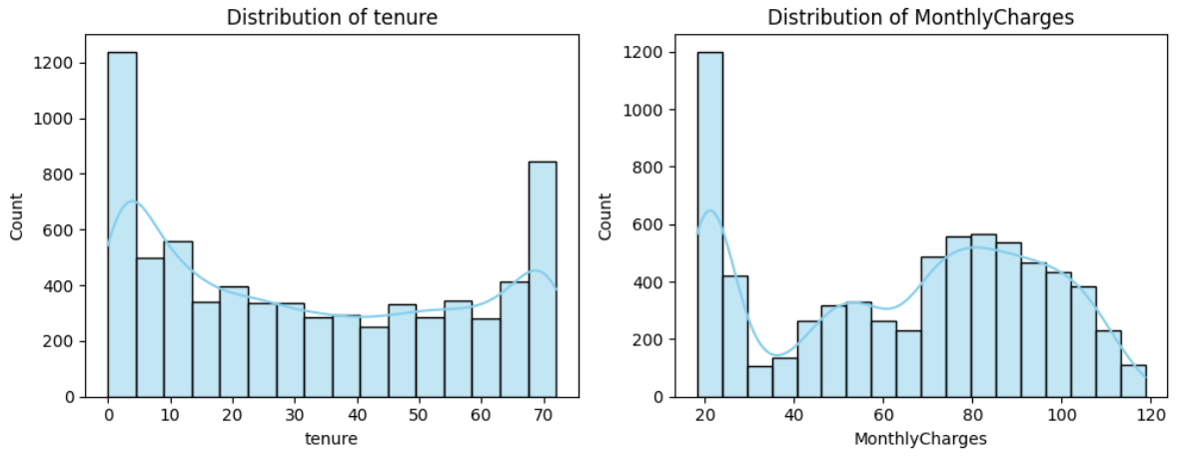
EDA: Visualization
Imbalanced data
Tenure distribution: bimodal, most customers churn too early or stay loyal.
Monthly Charge distribution: slightly right-skewed, most customers on low cost plans.

Slide 6
These are the steps we took to pre-process our dataset and make it ready for modeling:
Pre-processing
01
02
03
04
Handled NULLs and duplicates
Encoded binary and categorical features
Scaled numerical features
Feature Selection
Removed duplicates, and replaced NULL values with business meaningful values
Using OneHotEncoder
Using RobustScaler and MinMaxScaler to handle outliers
Excluded gender, phone_service as it has weak correlation and total_charges from linear model only as it’s derived from other features

Slide 7
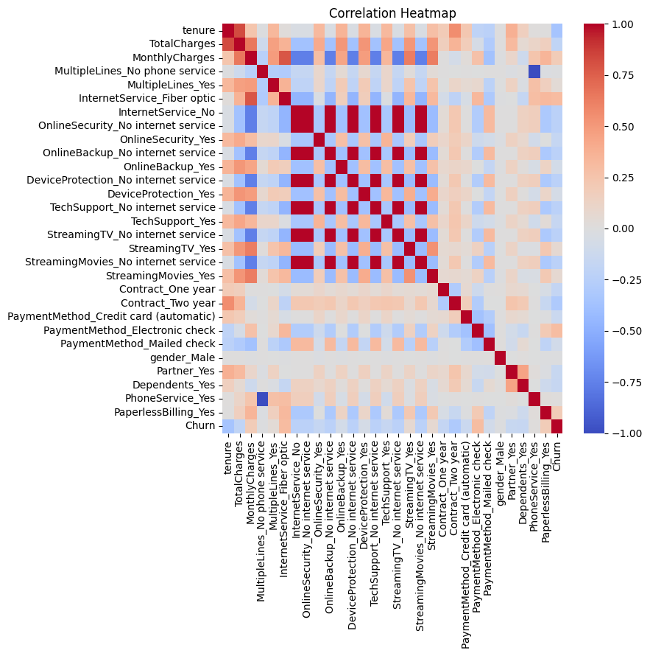
Correlation
For:
Linear models: drop total_charges to improve generalization and reduce redundancy.
Tree-Based models: keep total_charges for better model flexibility.
All models: drop gender, phone_service for minimal impact and lack of variability.

Slide 8
Each one of us worked on a specific model and tuned it to reach best results.
Modeling
Logistic Regression
Simple, easy to interpret
Scalable, easy to deploy
Logistic + SMOTE
To generate more records in our sample instead of using weights to balance data
XGBoost
Handles imbalance data well
High regularization that avoids overfitting
XGBoost + SMOTE
To generate more records in our sample instead of using weights to balance data
LightGBM
Handles imbalance data well
Efficient speed
(SMOTE = Synthetic Minority Over-sampling Technique)

Slide 9
We chose our main evaluation metric to be Recall because identifying FNs is the top priority to our business problem.
However, we also aim for: Acceptable Precision to ensure that we do not waste efforts or resources on customers who weren’t actually at risk.
80%
48%
78%
50%
79%
49%
79%
50%
62%
53%
Evaluation
Blue: Precision
Logistic Regression
Logistic + SMOTE
XGBoost
XGBoost + SMOTE
LightGBM

Slide 10
Deployment
Using Gradio

Slide 11

Ready for your questions!

Slide 12
Thank you!

